Slide 1
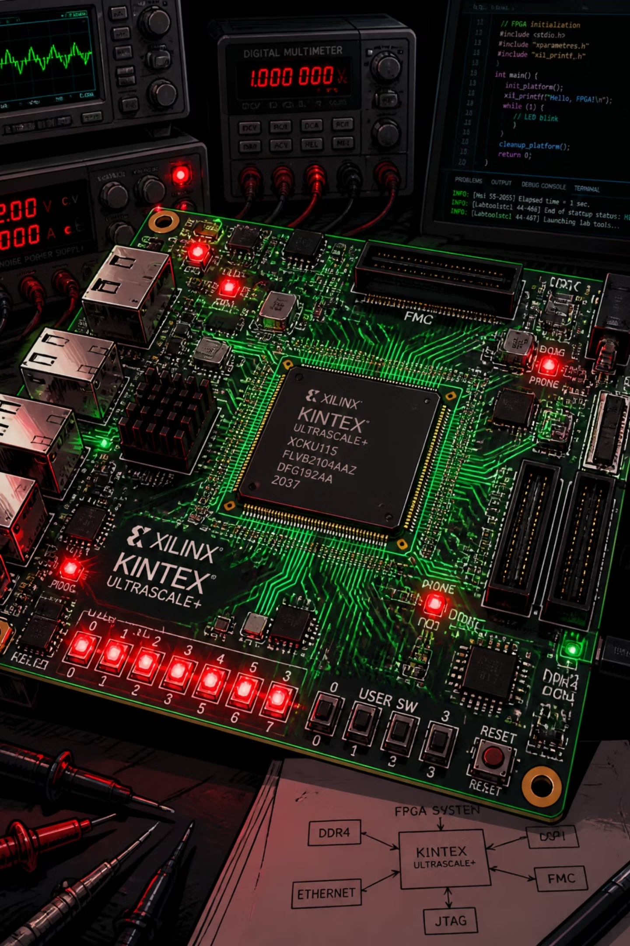

Design and Implementation of a Vending Machine Controller using Verilog
Presented By: Animesh Jaiswal | Atharv Singh | Shikhar Shukla
Department of Electronics & Communication Engineering
Guided By: Mr. Manoj Srivastava
VLSI DESIGN PROJECT
MOORE FSM ARCHITECTURE

Slide 2
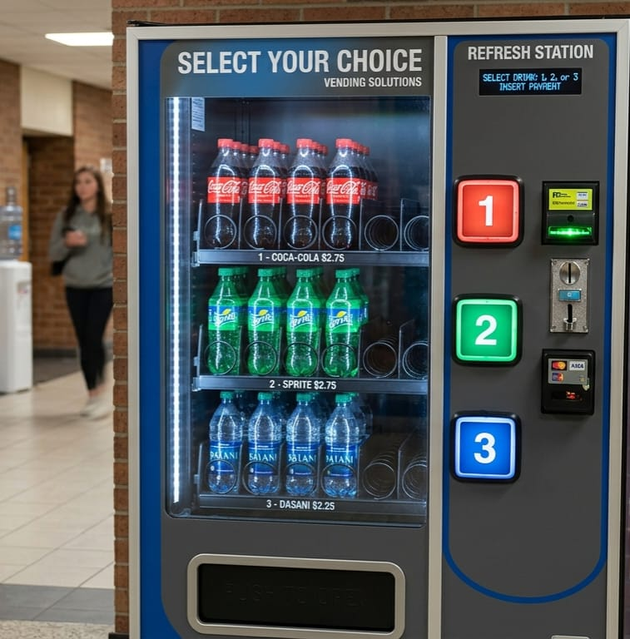




What is a Vending Machine Controller?
A digital system that accepts coins, verifies payment, allows product selection, dispenses the item, and returns change all governed by a Moore Finite State Machine implemented in Verilog HDL.
​Verilog is a Hardware Description Language (HDL) used to model, simulate, and design digital electronic systems.
Railway & Airports
High-traffic automated retail
Schools & Hospitals
Reliable, low-maintenance access
Malls & Offices
24/7 unattended service

Slide 3


Problem Statement & Objectives
The Challenge
Our Objective
Design an FPGA-based controller that:
Accurate payment verification under all conditions
Fast, error-free change calculation
Accepts ₹5, ₹10, and ₹20 coins
Supports four product selections
Calculates and returns change automatically
Displays balance on a seven segment display
Dispenses the selected product reliably
Minimal human intervention
Continuous, reliable operation

Slide 4


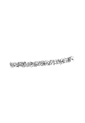
Tools & Software Used
Verification & Hardware
Testbench — Self-checking Verilog testbench covering all coin sequences, product selections, and edge cases (reset, under/over payment)
FPGA Board — Physical deployment for I/O validation (switches for coins, LEDs for dispense, 7-segment for balance)
Constraints File (.xdc) — Pin assignments mapping Verilog ports to physical FPGA pins
Design & Simulation
Verilog HDL — RTL source code for FSM, datapath, and display driver
Xilinx Vivado — Synthesis, implementation, and FPGA bitstream generation
ModelSim — Functional simulation of testbenches
ISim — Waveform visualization for debugging signal transitions
All modules are written in synthesizable Verilog no system tasks or delays in RTL code.

Slide 5
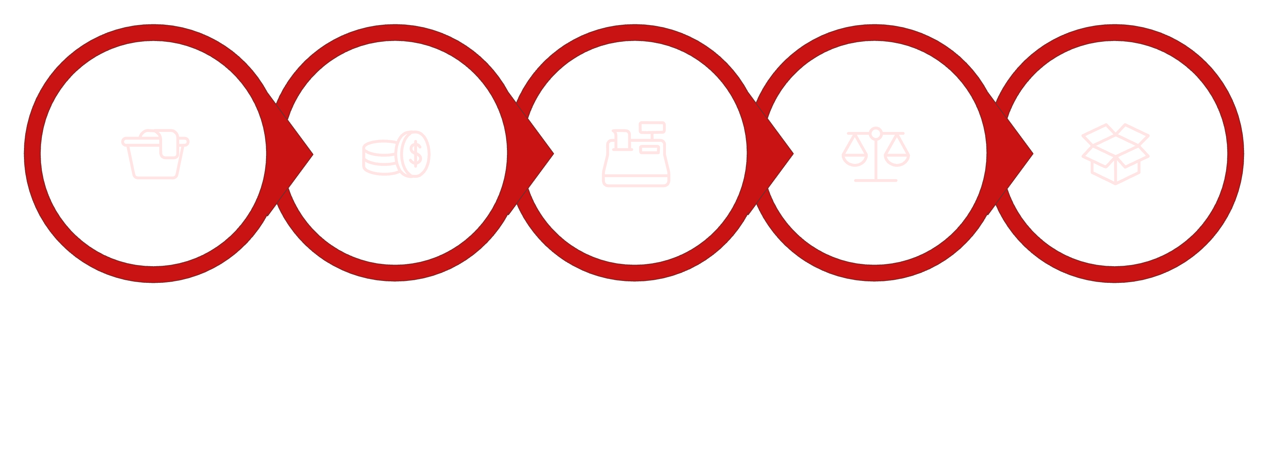

System Workflow
The controller follows a deterministic sequence governed by a Moore FSM outputs depend only on the current state, ensuring glitch free operation.
Select Product
Insert Coins
Update Balance
Compare Balance
Dispense Product
Registers store the running balance, the comparator validates payment sufficiency, and the arithmetic unit computes exact change all synchronized to the system clock.

Slide 6
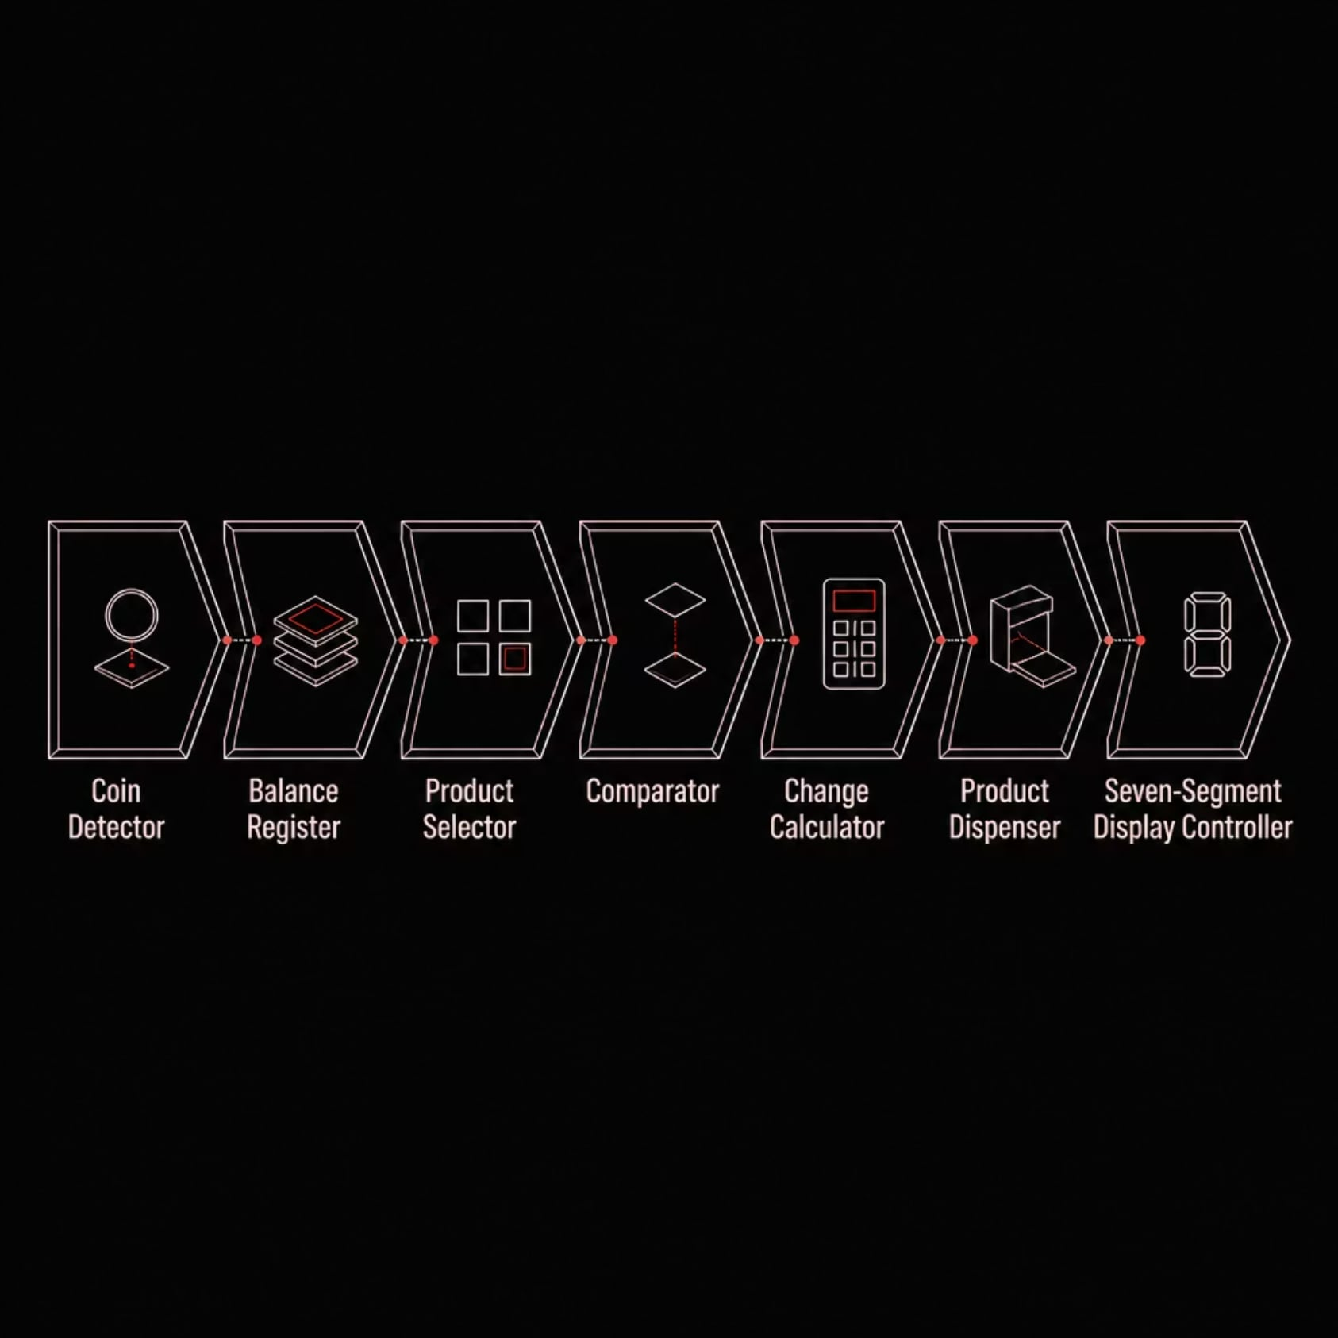

Architectural Block Diagram
Key Modules
Coin Detector — Identifies ₹5, ₹10, ₹20 inputs
Balance Register — Accumulates inserted value
Comparator — Checks balance ≥ product price
Change Calculator — Computes balance − price
Display Controller — Drives seven-segment output

Slide 7
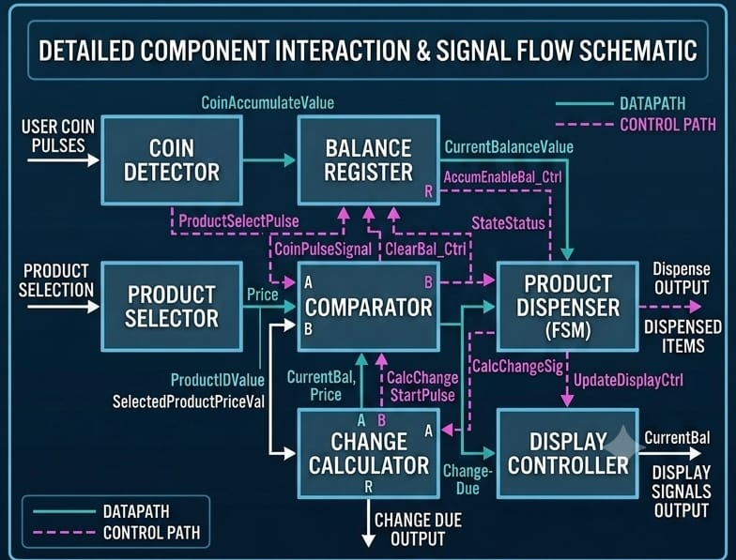
Design Features
Hardware Architecture
Moore Finite State Machine — state outputs are stable
Structural Verilog HDL — modular, synthesizable code
FPGA-compatible design — portable across platforms
Functional Capabilities
Three coin denominations: ₹5, ₹10, ₹20
Four selectable products with distinct prices
Automatic balance update and change return
Seven-segment display for real-time balance feedback
Asynchronous reset for system initialization

Slide 8
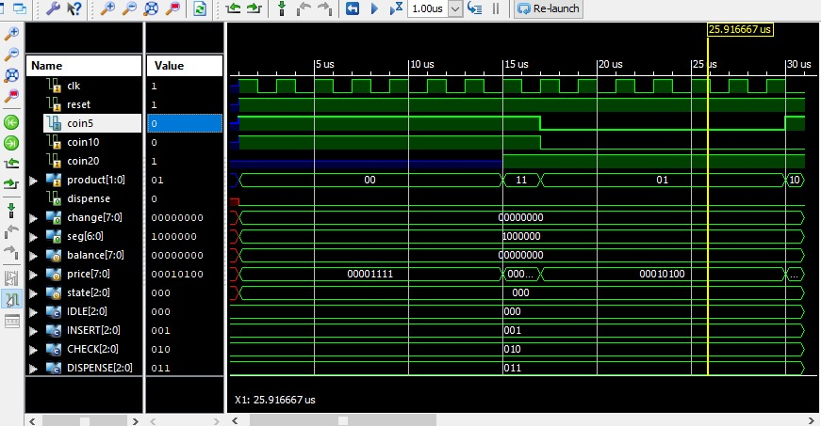


Verilog Design & Simulation Results
Implementation Stack
Simulated using Xilinx Vivado / ISE all testbenches verified for corner cases including exact payment, overpayment, and insufficient funds.
Verification Checklist
✔ Coin detection and denomination recognition
✔ Balance register updates correctly
✔ Comparator validates payment threshold
✔ Product dispense signal asserted
✔ Change calculated and displayed accurately
For product reference:
// Product Selection
// 00 = Chips (15)
// 01 = Coke (20)
// 10 = Biscuit (25)
// 11 = Chocolate (30)
Moore FSM
Registers
Comparator
7-Seg Decoder
State encoding & transitions
Balance accumulation
Price validation
BCD to display output

Slide 9


Advantages & Limitations
Advantages
Current Limitations
Fast, glitch-free FSM-driven response
Accurate arithmetic with zero rounding errors
Fully automated — no manual intervention
Modular, reusable Verilog architecture
Low hardware complexity on FPGA fabric
Easily expandable for additional features
Fixed coin set no custom denomination support
Limited to four predefined products
No present design supports sequential currency detection, where only one note or coin is processed at a time.
No inventory or stock monitoring
Seven-segment display only no rich UI
Limitations are architectural choices, not design flaws each is addressable in future iterations.

Slide 10

Comparison with Existing Systems
Attribute
Traditional Machine
Proposed Verilog Controller
Implementation
Mechanical / Relay based
Digital FPGA based
Maintenance
Higher moving parts wear
Low solid-state logic
Processing Speed
Slower, latency prone
High speed, clock-synchronous
Flexibility
Fixed wiring, hard to modify
Reprogrammable via firmware
Architecture
Monolithic, hard-wired
Modular, reusable blocks
Control
Semi-manual
Fully automatic FSM
Our design demonstrates that FPGA based digital control offers superior speed, maintainability, and scalability over legacy mechanical approaches.

Slide 11

Conclusion & Future Scope
Conclusion
Current Enhancements
The Verilog-based vending machine controller was successfully designed, implemented, and simulated. All functional requirements coin acceptance, product selection, balance comparison, dispensing, change calculation, and display were verified across all test scenarios.
UPI / QR code & NFC payment integration
LCD / TFT display with touchscreen UI
IoT-based remote monitoring & analytics
SIMULATION VERIFIED
FPGA READY
Product inventory management system
Mobile app connectivity & voice guidance

